Slide 1
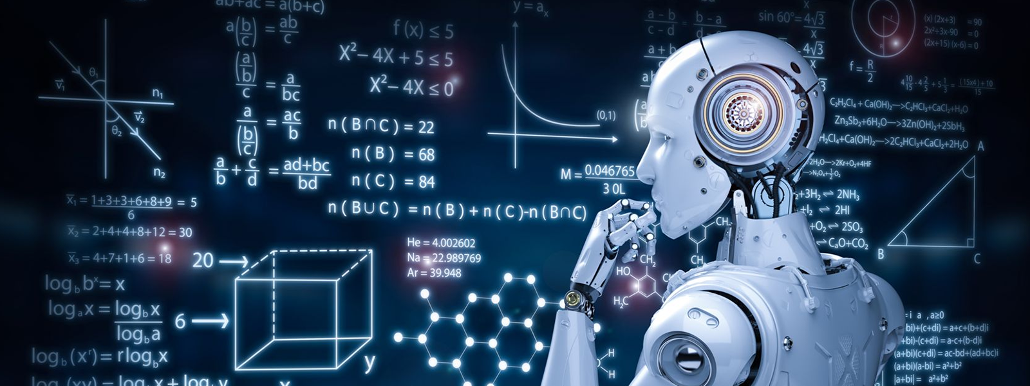
Tutorial 2
﻿Machine Learning Overview
Hongzong Li
Department of Computer Science City University of Hong Kong

Slide 2
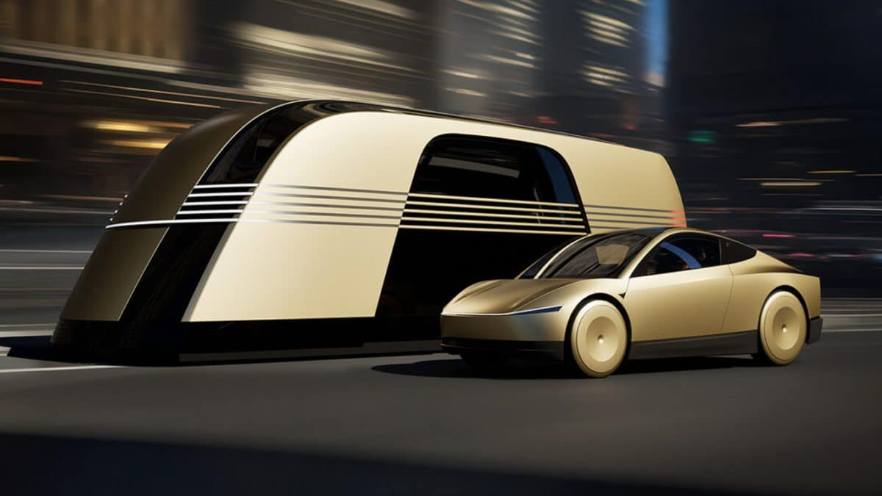
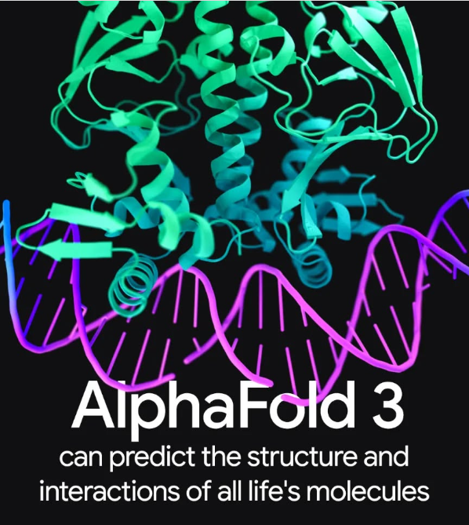
Machine Learning
Machine learning is most prominent and visible use case of data science and artificial intelligence. From Tesla’s self-driving cars to DeepMind’s AlphaFold algorithm, machine-learning-based solutions have produced awe-inspiring results and generated considerable hype.
Notes:
provides an intuitive definition of key machine-learning algorithms, outlines some of their key applications, and provides resources for how to get started with machine learning.

Slide 3
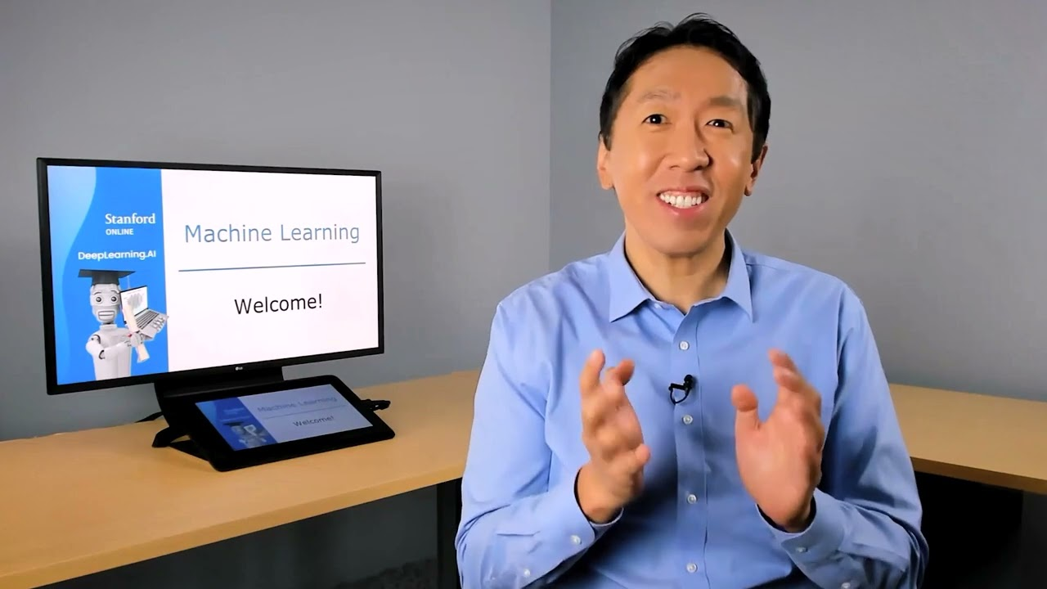
Machine Learning
Artificial Intelligence
One of the best definitions of artificial intelligence comes from Andrew Ng, co-founder of Google Brain and former Chief Scientist at Baidu.
According to Andrew, artificial intelligence is a “huge set of tools of making computers behave intelligently.” This can include anything ranging from explicitly defined systems like calculators to machine learning-based solutions like spam email detectors.

Slide 4
Machine Learning
Machine learning is a subfield of artificial intelligence in which algorithms learn patterns from historical data and provide predictions or decisions based on these learned patterns by applying them to new data.
Historical Data
Machine Learning
Learned Patterns
New Data
Predictions/Decisions

Slide 5
Machine Learning
Developers can try and create spam filters by explicitly defining them. For example, they can define a program that triggers a spam filter if an email has a certain subject line or contains certain links. However, this system will prove ineffective as soon as spammers change tactics.
？
A program
“ping.多*多砍一D”
“拼多多砍一刀”
Spam
On the other hand, a machine learning-based solution will take in millions of spam emails as input data, learn the most common characteristics of spammy emails through statistical association, and make predictions on future emails based on the learned characteristics.
Machine Learning
Training Data
learned characteristic
Notes:
Let’s take the example of email spam filters.

Slide 6
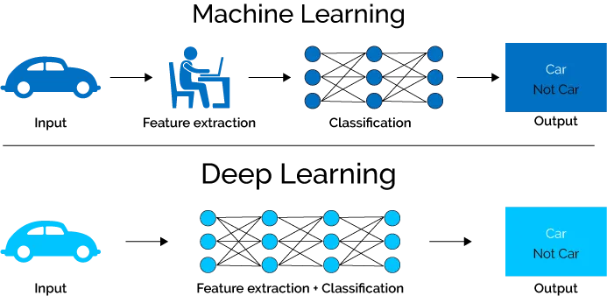
Machine Learning
Deep Learning
Deep learning is a subfield of machine learning and is probably responsible for popular machine learning use cases. Deep learning algorithms are inspired by the structure of the human brain and require incredible amounts of data for training. They are often used for the most complex “cognitive” problems, such as speech detection, language translation, self-driving cars, and more.

Slide 7
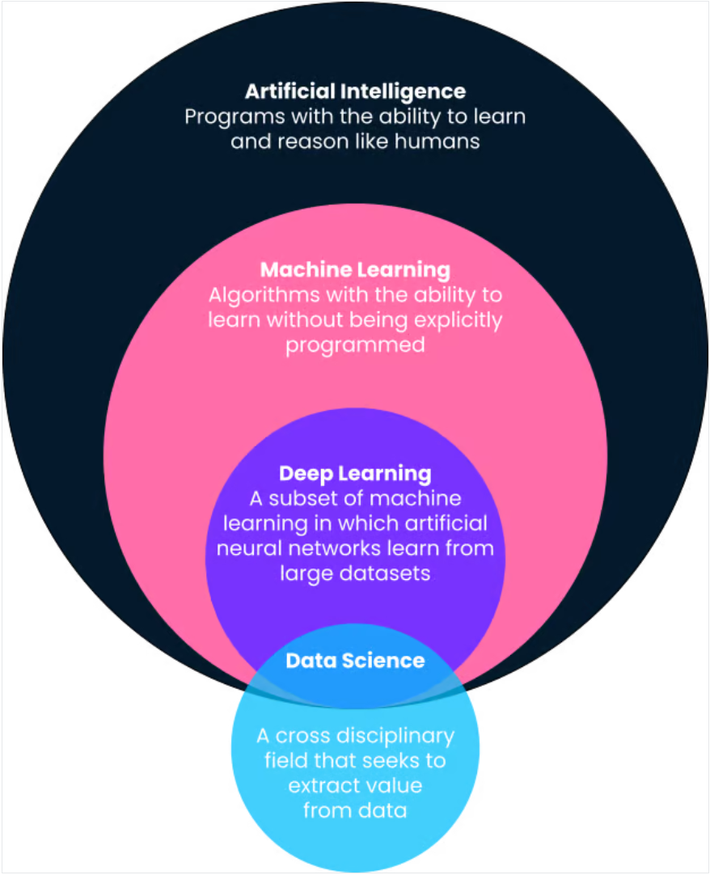
Machine Learning
Data Science
Data science is an interdisciplinary academic field that uses statistics, scientific computing, scientific methods, processing, scientific visualization, algorithms and systems to extract or extrapolate knowledge and insights from potentially noisy, structured, or unstructured data.
Data Science focuses on handling, processing, and analyzing data, using statistics, programming, and machine learning algorithms to derive insights and predictions from data.

Slide 8
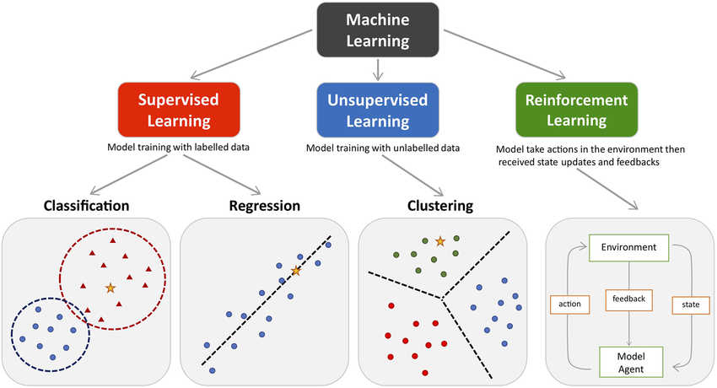
Machine Learning
Machine learning algorithms are broadly categorized into supervised, unsupervised, reinforcement, and self-supervised learning.

Slide 9
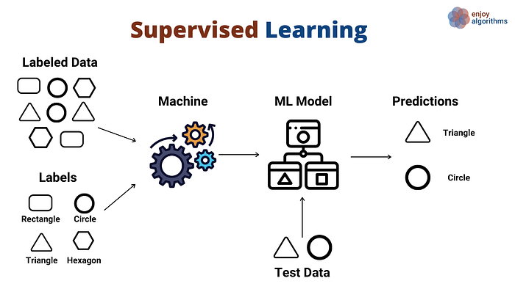
Supervised Machine Learning
Most machine learning use cases revolve around algorithms learning patterns from historical data and applying them to new data in the form of predictions. This is often referred to as supervised learning.

Slide 10
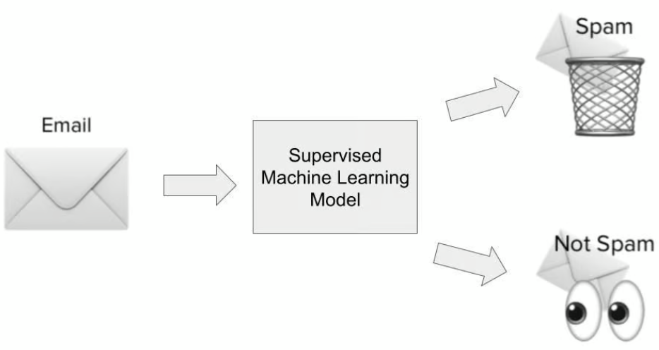
Supervised Machine Learning
In the spam detection use case, a supervised learning algorithm would be trained on a dataset of spammy emails. The inputs would be features or dimensions about the emails, such as the email subject line, the sender's email address, the contents of the email, whether the email contained dangerous-looking links, and other relevant information that could give clues about whether an email is spammy.

Slide 11
Supervised Machine Learning
The output would be whether, in fact, that email was spam or not. During the model learning phase, the algorithm learns a function to map the statistical relationship between the set of input variables (the different dimensions of spammy email) and the output variable (whether it was spam or not). This functional mapping is then used to predict the output of the previously unseen data.

Slide 12
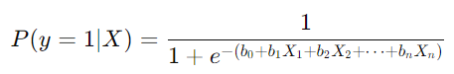
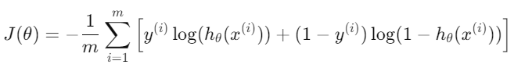
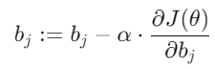
Supervised Machine Learning
Logistic Regression
1. Prepare the Data
2. Define the Logistic Function
Use the sigmoid function to model the probability of the target being 1 (positive class):
3. Initialize Parameters
Initialize the model parameters (weights), usually to small random values.
4. Calculate the Cost Function
Define the log-loss (cross-entropy) cost function to measure the model's error.
5. Optimize the Parameters
Use gradient descent to minimize the cost function and update the model’s parameters.
6. Make Predictions
if the probability is greater than 0.5 (class 1) or less than 0.5 (class 0).

Slide 13
Supervised Machine Learning
There are broadly two types of supervised learning use cases:
Regression: Regression use cases are when we try to predict a continuous outcome that falls within a range. A good example would be house price prediction based on the square footage of the house, where it’s located, the number of bedrooms, and other relevant dimensions.
Classification: Classification use cases are when we try to classify whether an outcome falls within two or more categories. Spam detectors are classification models (either spam or not spam) — but other classification use cases include customer churn prediction (will churn or not churn), identifying cars in pictures (multiple categories), and more.

Slide 14
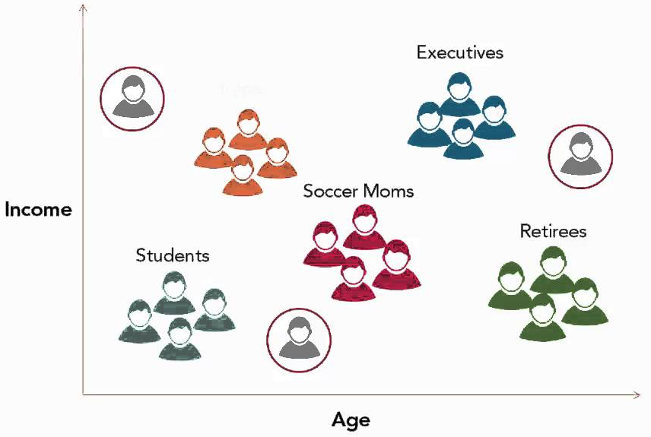
Unsupervised Machine Learning
Instead of learning patterns that map inputs to outputs, unsupervised learning algorithms discover general patterns in data without being explicitly shown outputs. Unsupervised learning algorithms are commonly used to group and cluster different objects and entities. A great example of unsupervised learning is customer segmentation.

Slide 15
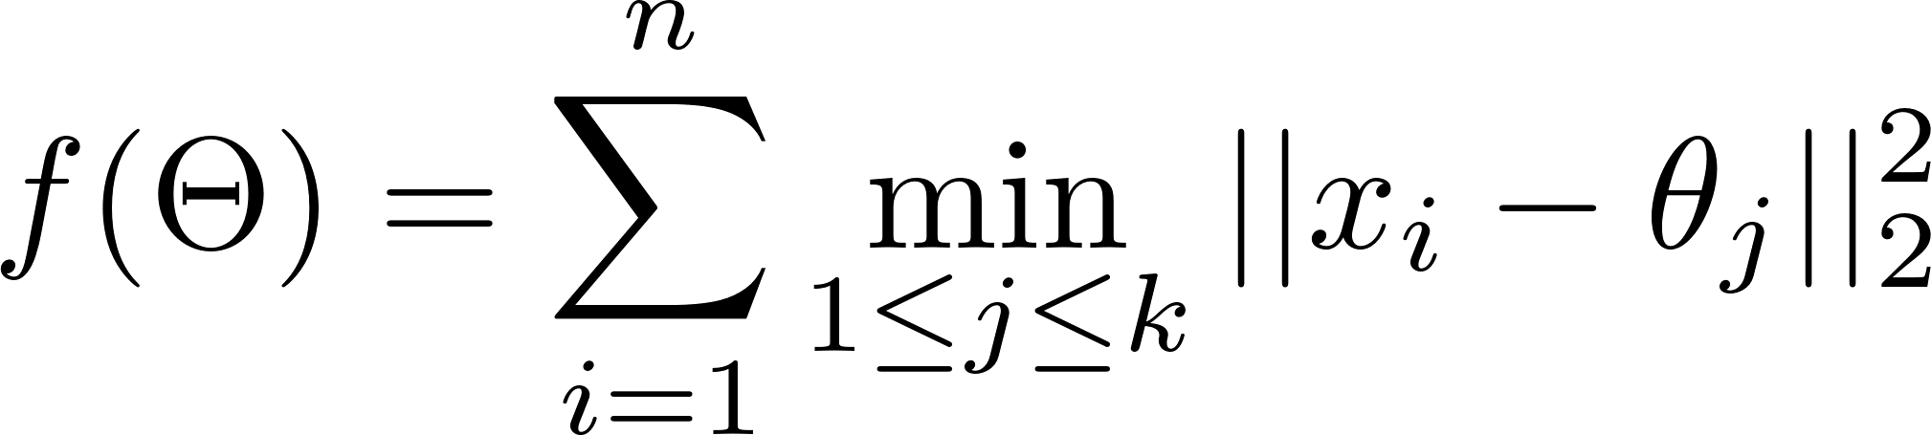
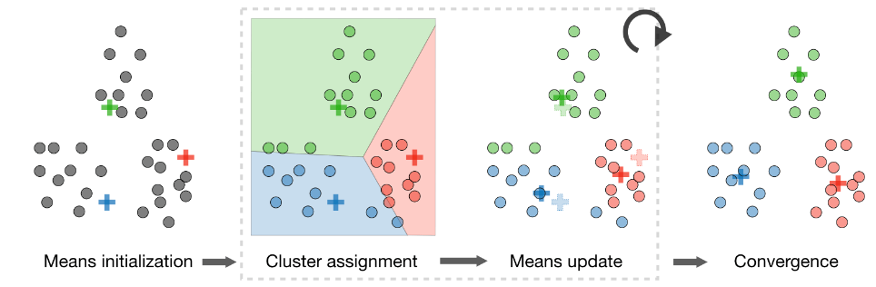
Unsupervised Machine Learning
k-means Clustering
The k-means algorithm is one of the most popular unsupervised learning algorithms.

Slide 16
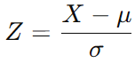
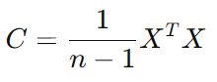
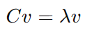
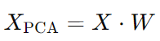
Unsupervised Machine Learning
Generally, the more information they have about a particular problem, the better. However, that could also lead to slow training times and performance. Dimensionality reduction techniques help reduce the number of features present within a dataset without sacrificing predictive value. Unsupervised algorithms are also used to reduce the dimensions in a dataset (i.e., the number of features. These algorithms are often used as an intermediary step in training a supervised learning algorithm.
Principal Component Analysis (PCA)
Standardize the data.
Compute the covariance matrix of the standardized data.
Compute the eigenvalues and eigenvectors of the covariance matrix.
Sort the eigenvectors by eigenvalues in descending order.
Select the top k eigenvectors to form the projection matrix.
Project the data onto the top k components to obtain the reduced data.

Slide 17

Unsupervised Machine Learning
Principal Component Analysis (PCA)

Slide 18

Reinforcement Learning
Reinforcement learning is a subset of machine learning algorithms that utilize rewards to promote a desired behavior or prediction and a penalty otherwise.

Slide 19
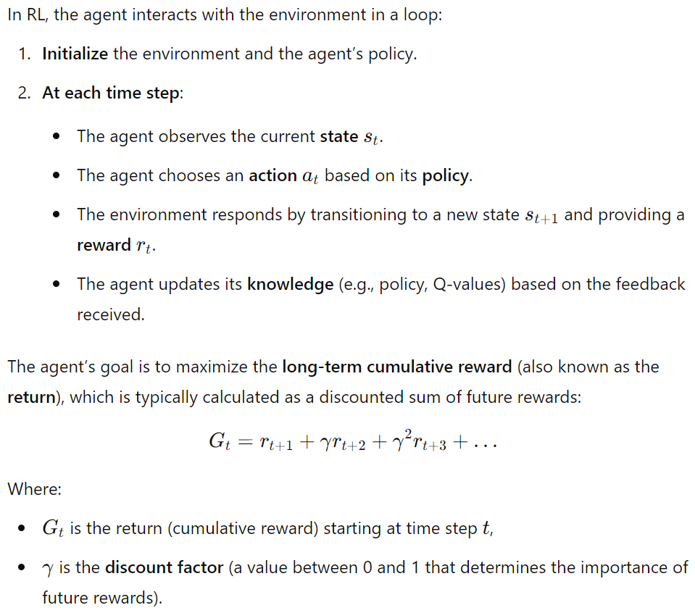
Reinforcement Learning
The Reinforcement Learning Process

Slide 20
Reinforcement Learning
Model-Free RL:
The agent does not have a model of the environment (i.e., it does not know the dynamics of the system).
Examples: Q-learning, SARSA.
Model-Based RL:
The agent learns a model of the environment, which it can use to predict the consequences of actions and plan accordingly.
Examples: Dyna-Q, Monte Carlo Tree Search.

Slide 21
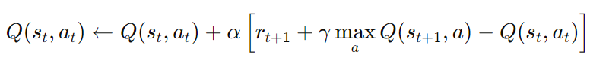
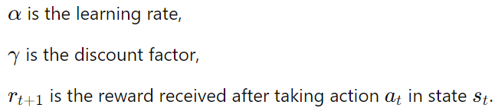
Reinforcement Learning
Q-Learning
A model-free RL algorithm that learns the value of each state-action pair. The agent updates a table of Q-values, which estimates the expected future reward for each action taken in each state.
The update rule is:
Deep Q-Network (DQN): version of Q-learning that uses a neural network to approximate the Q-values. This approach is useful for handling high-dimensional state spaces, such as images.

Slide 22
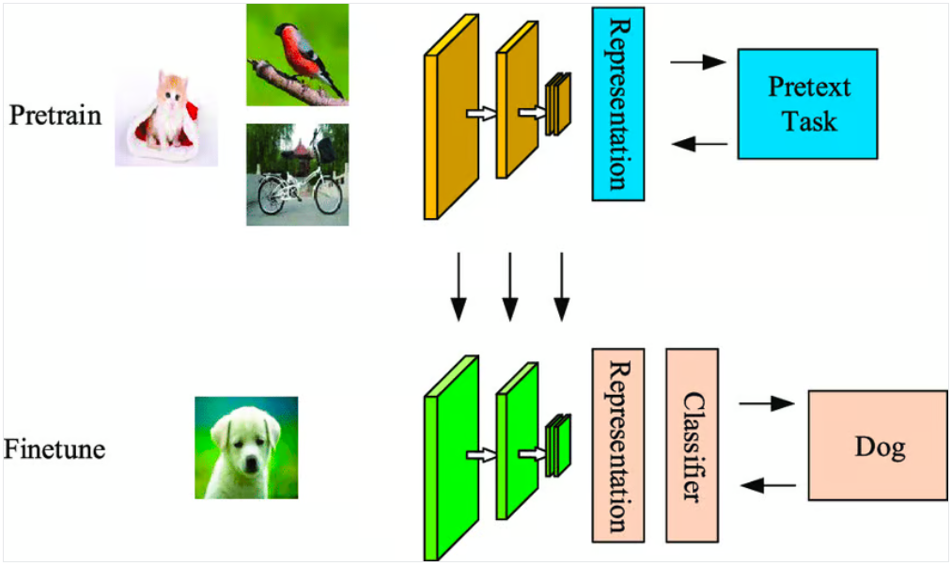
Self-Supervised Learning
Self-supervised learning (SSL) is a type of unsupervised learning where the model generates pseudo-labels or auxiliary tasks from the input data itself, without needing explicit labels. This enables the model to learn useful representations from unlabeled data. These representations can then be used for downstream tasks like classification, regression, or even reinforcement learning.

Slide 23
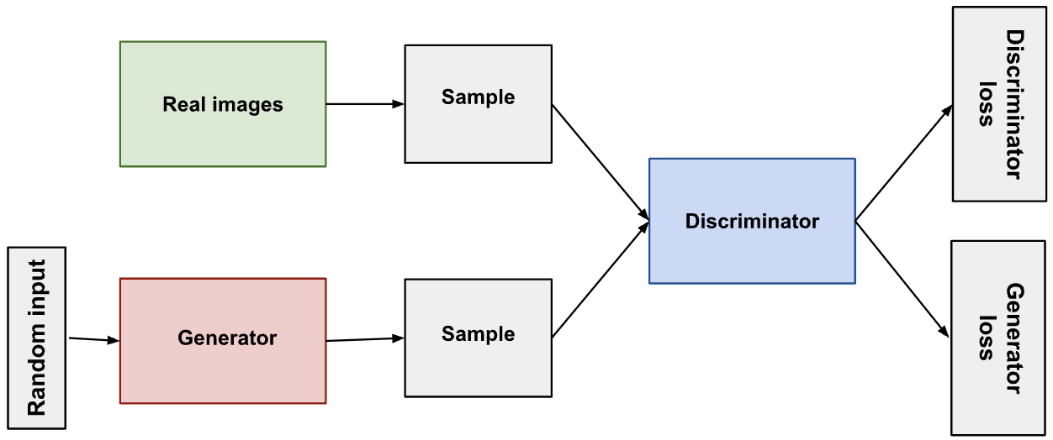
Self-Supervised Learning
GAN
Generative Adversarial Networks (GANs) are a class of deep learning models that consist of two neural networks, a generator and a discriminator, which are trained together in a competitive manner.
The generator learns to generate plausible data. The generated instances become negative training examples for the discriminator.
The discriminator learns to distinguish the generator's fake data from real data. The discriminator penalizes the generator for producing implausible results.

Slide 24
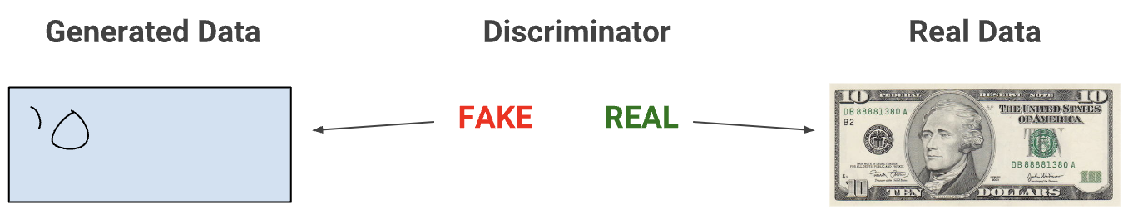
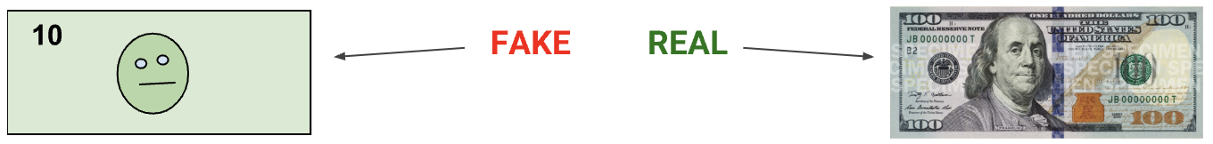
Self-Supervised Learning
GAN
When training begins, the generator produces obviously fake data, and the discriminator quickly learns to tell that it's fake:
As training progresses, the generator gets closer to producing output that can fool the discriminator:

Slide 25
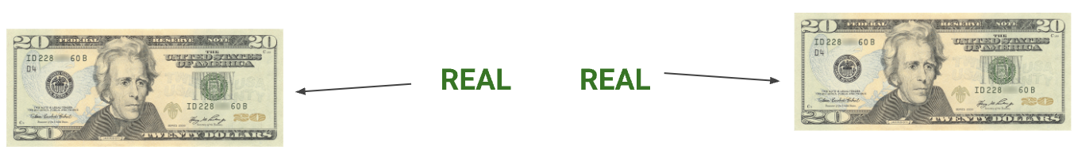
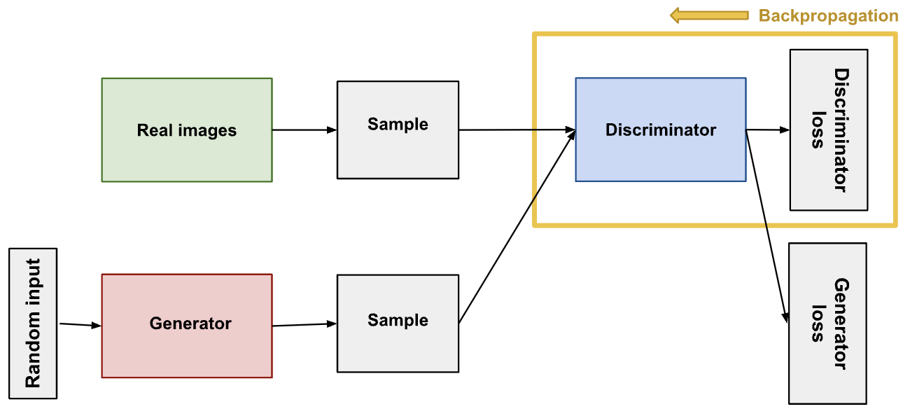
Self-Supervised Learning
GAN
Finally, if generator training goes well, the discriminator gets worse at telling the difference between real and fake. It starts to classify fake data as real, and its accuracy decreases.
The discriminator connects to two loss functions. During discriminator training, the discriminator ignores the generator loss and just uses the discriminator loss. We use the generator loss during generator training

Slide 26
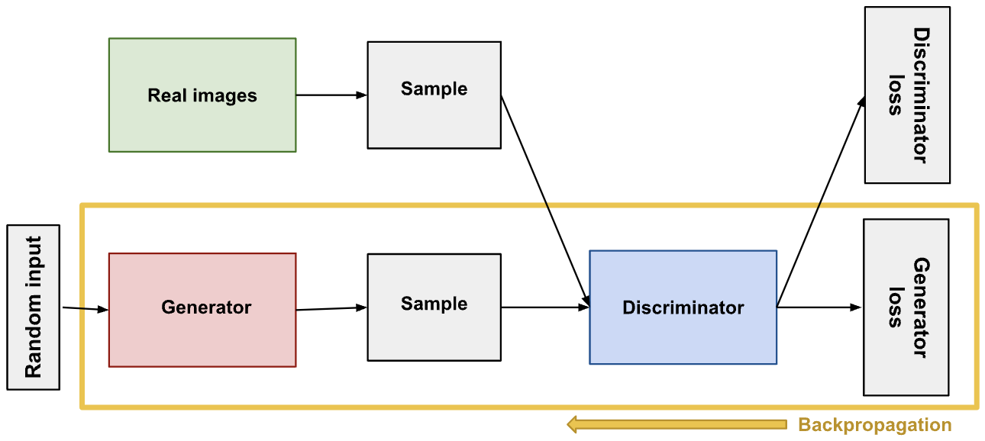
Self-Supervised Learning
GAN

Slide 27





Python for Machine Learning
Python is one of the most widely used programming languages for machine learning because of its simplicity and the rich ecosystem of libraries. Here are some key libraries:
NumPy: For numerical computations.
Pandas: For data manipulation and analysis.
Scikit-learn: For building and evaluating machine learning models.
Matplotlib/Seaborn: For data visualization.
TensorFlow/Keras/PyTorch: For deep learning.

Slide 28
Thanks

